Slide 1
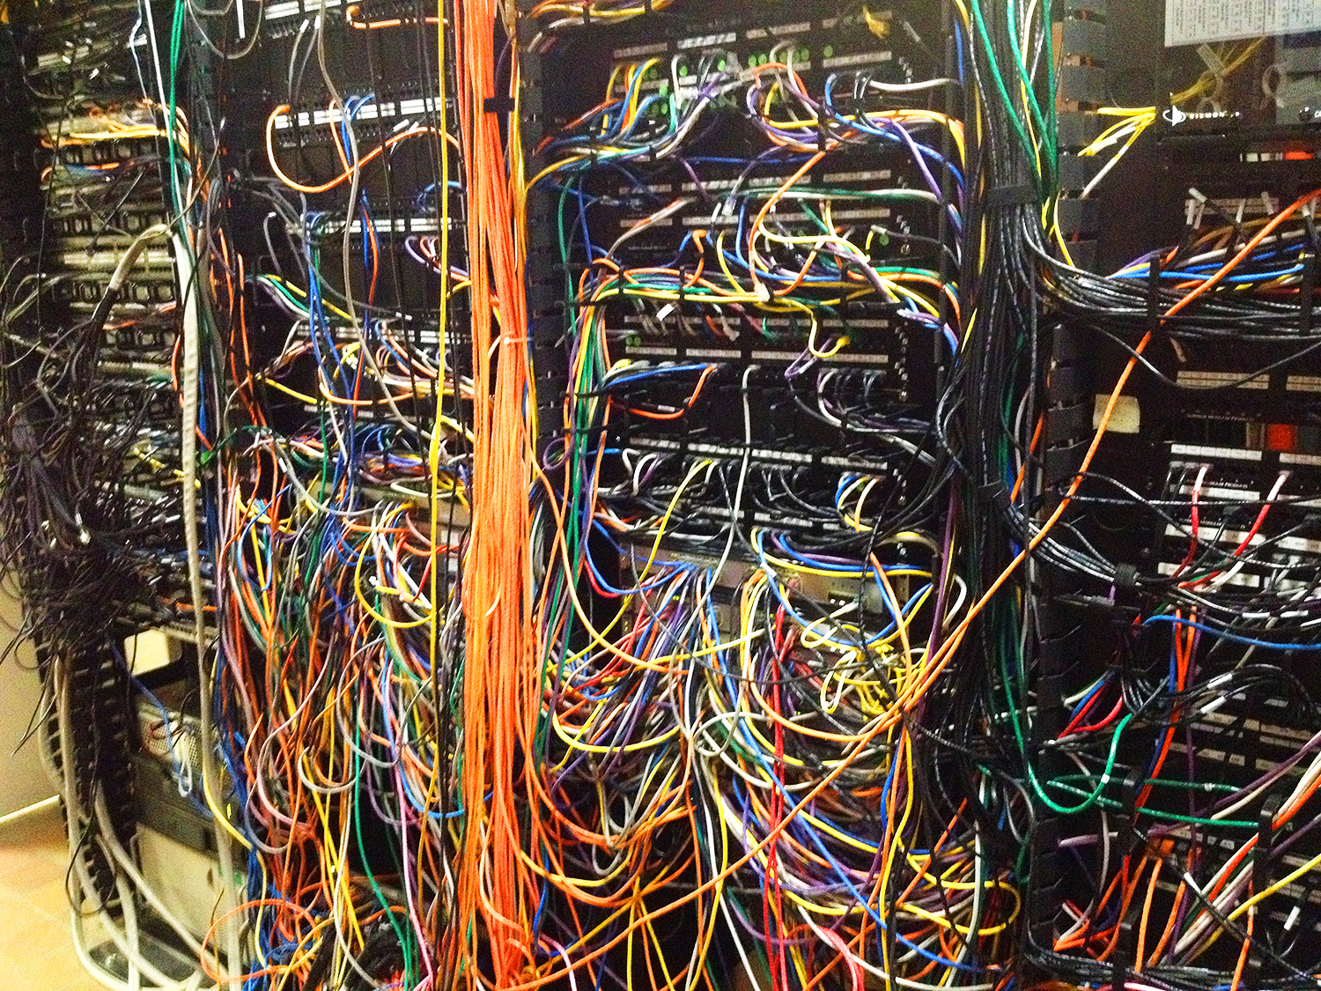
CS260: Computer Networks I Interprocess Communication

Slide 2




SIOBHAN Beeman (“shi-VAWN”) siobhan.beeman@digipen.edu
Office Hours: Monday 1-6pm and by appoitnment
http://www.linkedin.com/in/stebee
@ProfBeeman
Sorry, personal use only

Slide 3
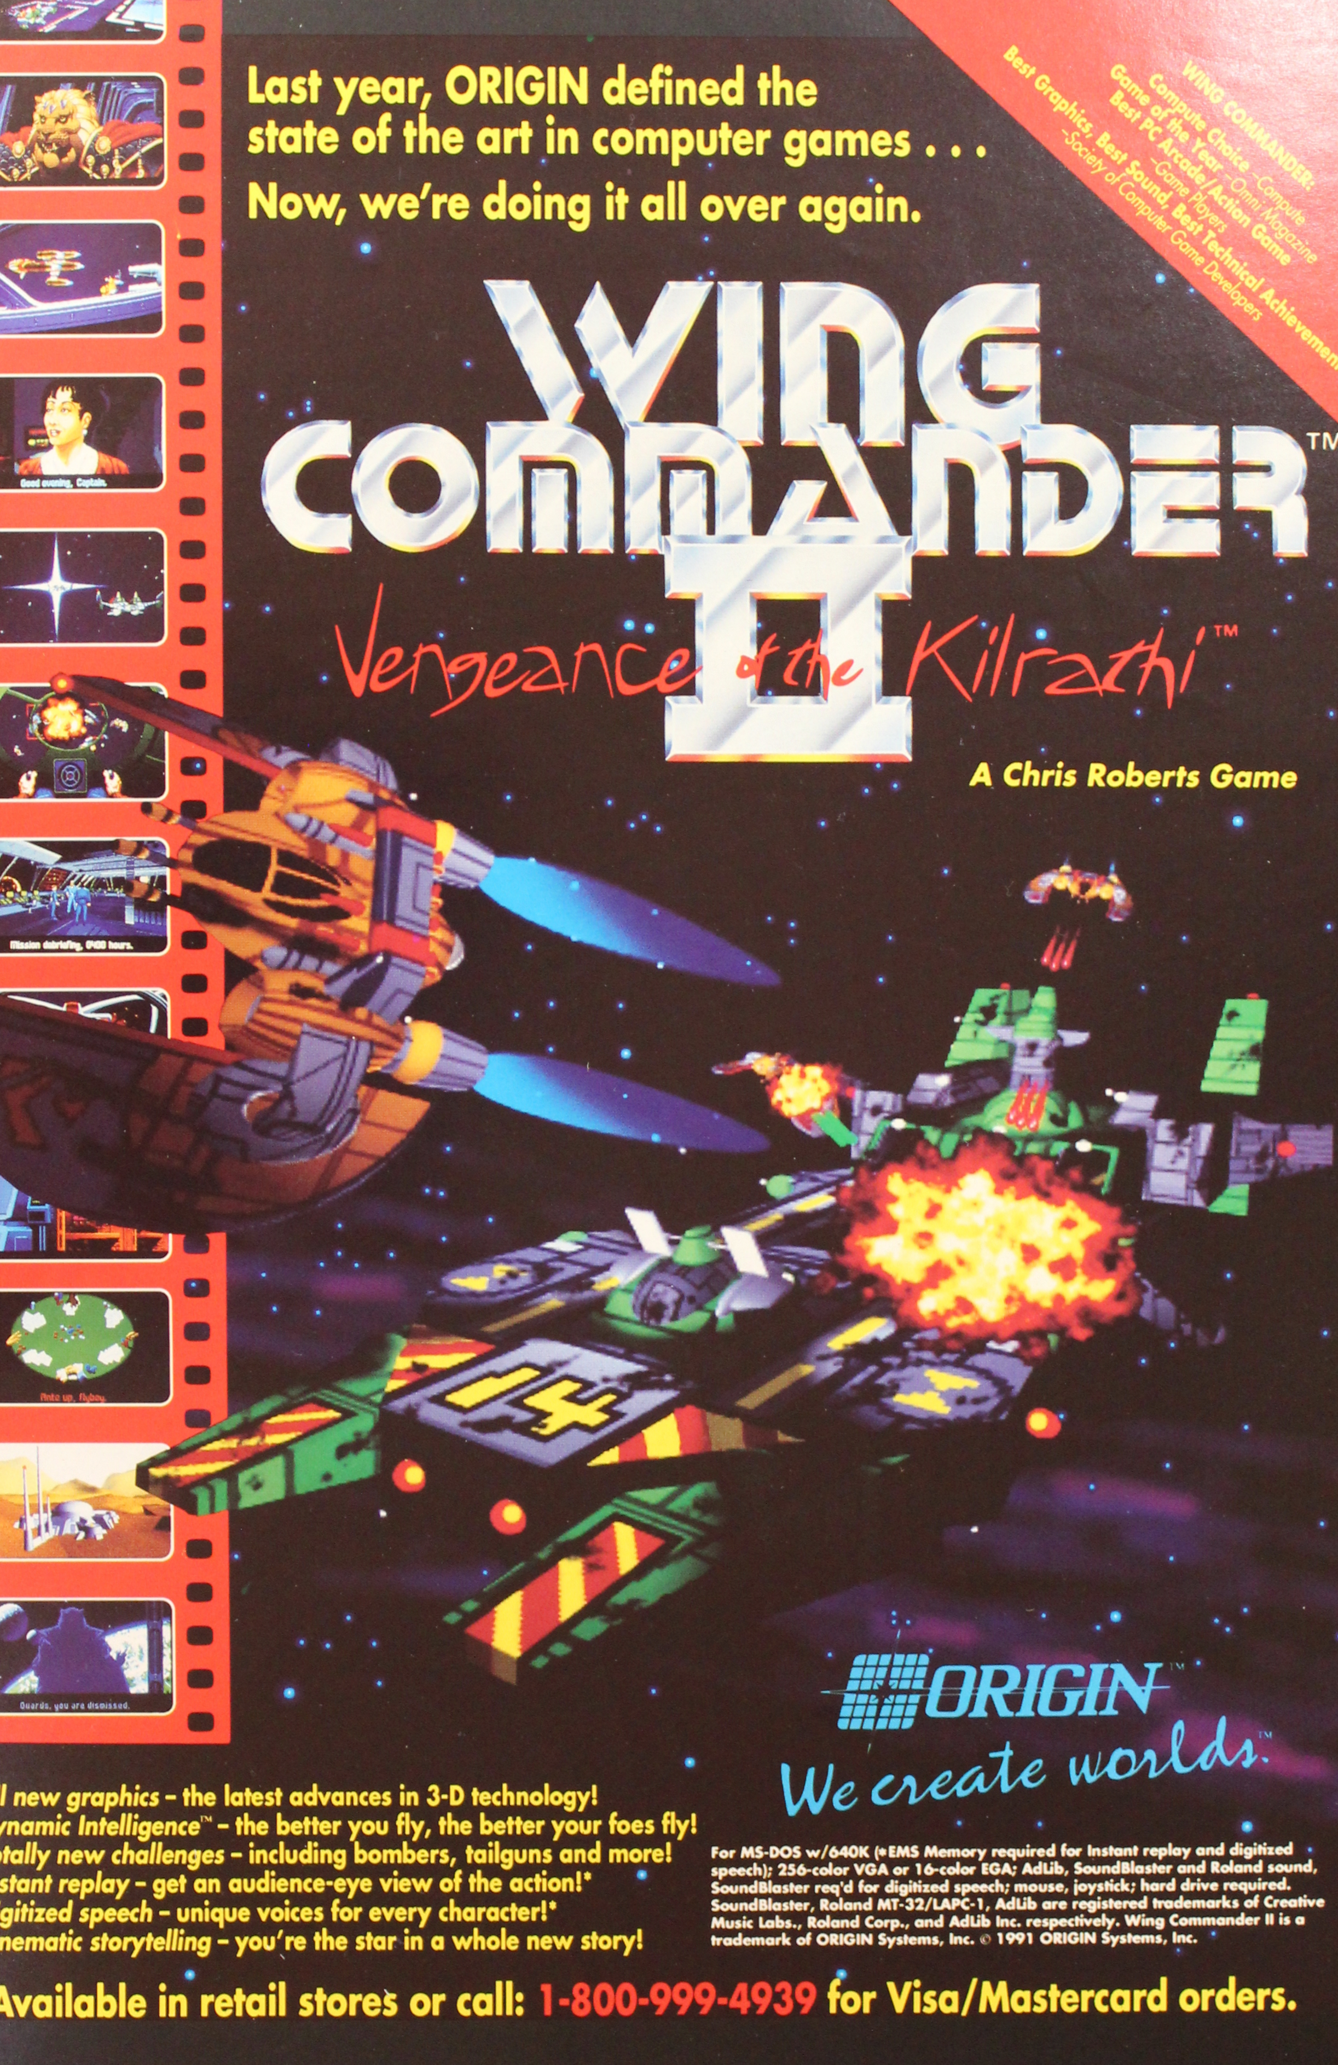
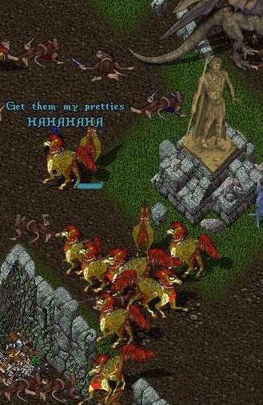
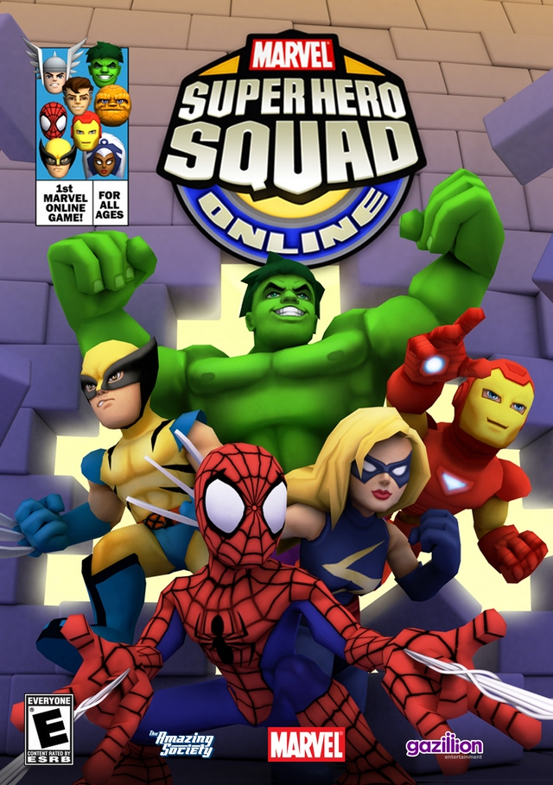
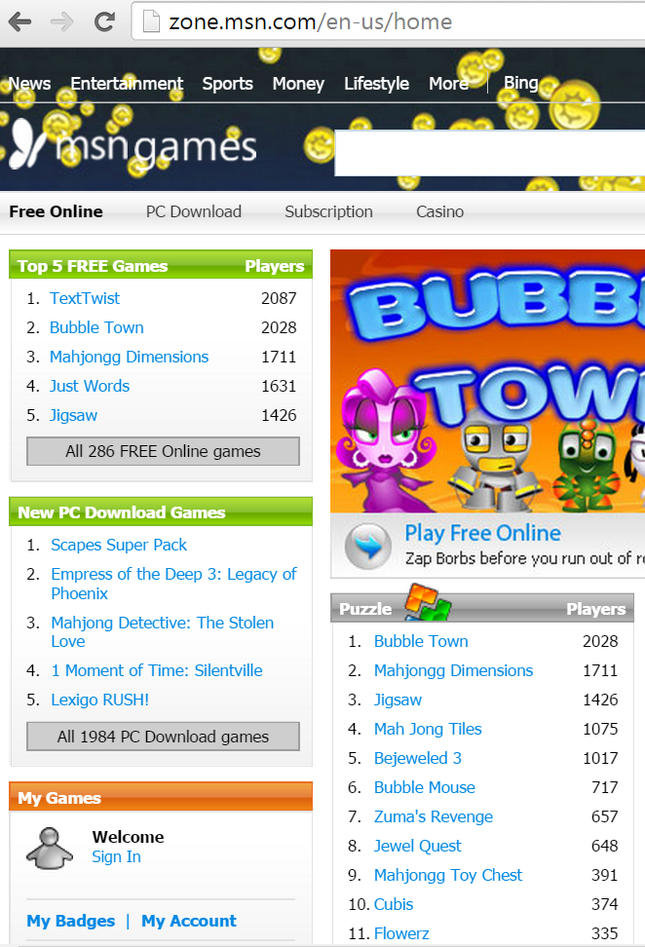
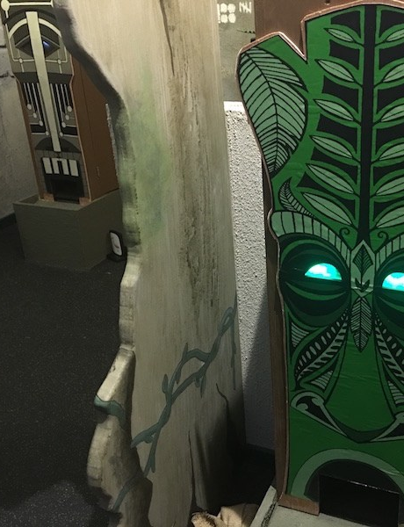
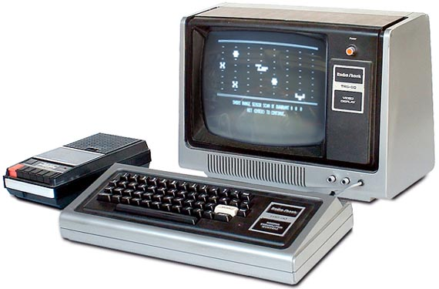
Notes:
Been programming since the age of 9… which isn’t all that big a deal today, but was more of a feat back when this was what a home computer looked like. [CLICK]
Schools like Digipen didn’t exist when I was your age, so instead of going to college I got a job at Origin Systems. So essentially this game [CLICK] was my senior project—in modern terms, I was the producer.
Worked at various companies after that… director of online technology for Origin during Ultima Online… [CLICK]
…head of server infrastructure and security for MSN Games [CLICK]…
…and lead server architect on the Marvel Superhero Squad MMO.

Slide 4
What is
Network
Programming

Slide 5
Card Game Design Database and Playtest Printer
Web Portal Development
Cyberattack Forensics
Distributed System Architecture
Content Management Service
Turn-Based Game State Synchronization
Code Redemption Server
Realtime Game State Synchronization
Customer Service Messaging System
Peer-to-Peer Digital Rights Management
Social Media Connectivity
MMO Live Service Maintenance
Realtime Location Sharing
Collaborative Level Editor
Security Audits
Achievements and Leaderboards
Notes:
“Network programming” is really broad and vague. This is what you probably think of when I say it [CLICK]. And sure, that’s important. But maybe 1% of all game developers even touch that kind of code. And for good reason—that’s absolutely the toughest kind of network programming there is. It’s the hardest to design originally, definitely the hardest to debug.
We are, quite frankly, not going to learn how to do that in this class. We’ll touch on it, to introduce you to the concepts involved, but going deeper than that is what CS261 is for.
But network programming is a lot broader than HALO. I’ve done realtime state synchronization. But here are all the other things I’ve done that fall under “network programming”. [CLICK] Frankly, at this point, virtually every game going forward is probably going to have at least some network element. There was a time when games didn’t have audio; then audio technology became ubiquitous, and so did game audio. Similarly, game networking is going to be ubiquitious.

Slide 6
A distributed system is one in which two or more processes work together to achieve a result.

Slide 7
Key Definitions
Processes are generically called “nodes”
A collection of nodes forms a “network”
Nodes communicate with each other via “messages”
Messages are composed of fragments called “packets”
The formal definition of a message format is a “protocol”

Slide 8
WHY CREATE DISTRIBUTED SYSTEMS?
Resource sharing / locality
Performance
Security
Reliability / fault tolerance
Scalability / economics
Mobility
Notes:
Historical order

Slide 9
What is
Network
Programming
Notes:
Hold that question. We’re going to come back to it.

Slide 10
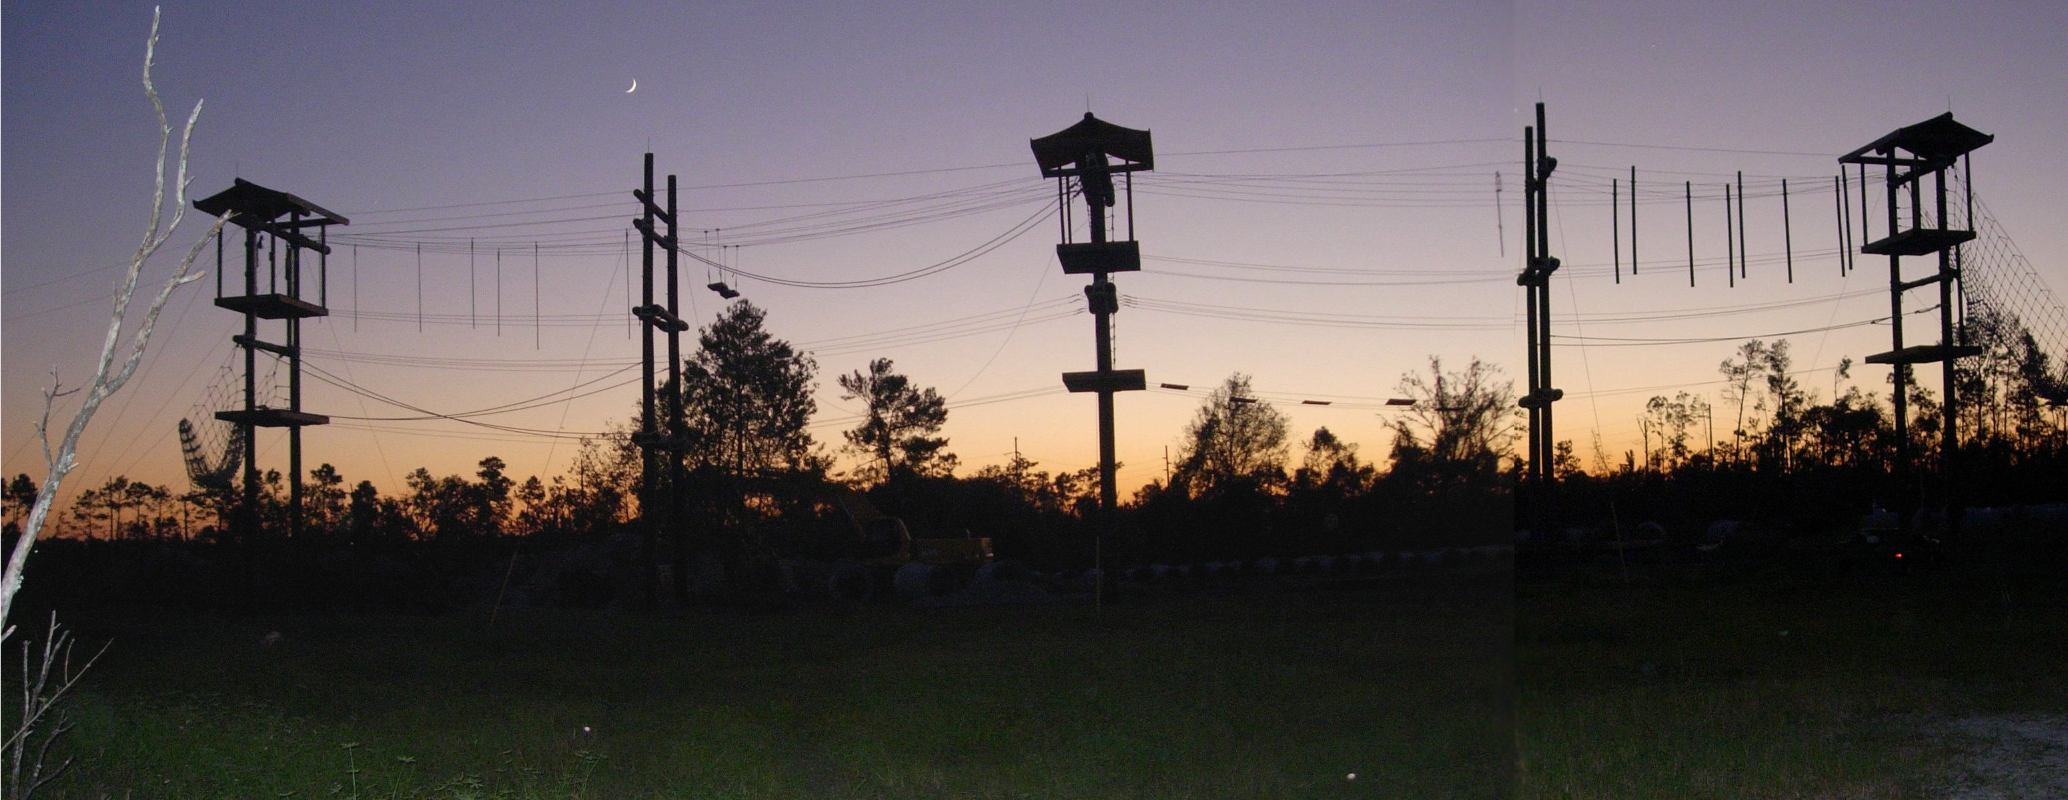
THE COURSE AHEAD

Slide 11
CS260 Objectives
Socket programming [introduced and reinforced]
How Internet sockets work
How to program sockets, on both Windows and Linux
Information security [introduced]
Basics of distributed systems [introduced]

Slide 12
GRADING
40% Projects
36% Exams (midterm and final)
24% Participation

Slide 13
Assignments (40%)
Four, spaced across the semester
Opportunity to resubmit
Each builds atop the previous
Put concepts from class into practice and receive feedback
Tips:
Read and follow the instructions
Test your code
Develop and follow a style
Ask questions!

Slide 14
Exams (36%)
About equal parts vocabulary, concepts and application
Pulled from all lectures and reading assignments
Midterm 12%, final 24%
Tips:
Attend class
Listen
Take notes
Ask questions!

Slide 15
Participation (24%)
10% Discussion and activities
14% Entrance and exit tickets

Slide 16
Barriers to participation
Shyness, fear of being wrong
This is a respectful and safe environment. Also, be sure to use the online forums!
Not used to it.
It’s new for me too!
Don’t know the answer.
I want wrong answers. Save the right answers for the exam!

Slide 17
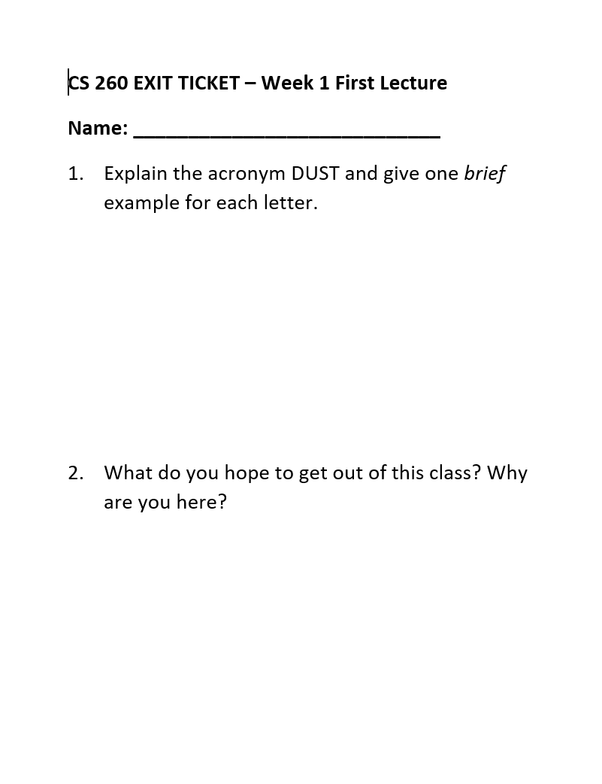
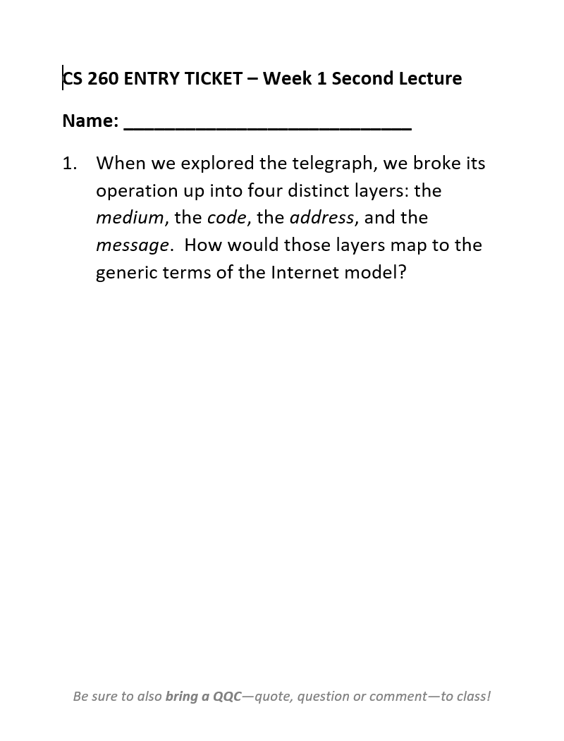
EXIT AND ENTRY TICKETS (14%)
One point per week.
Exit tickets are tiny review essays at the end of each class.
Entry tickets are tiny essays about the reading assignment.
Tips:
Do them!
Exit tickets are done in class.
Entry tickets may not be done in class.
They’re not trick questions.

Slide 18
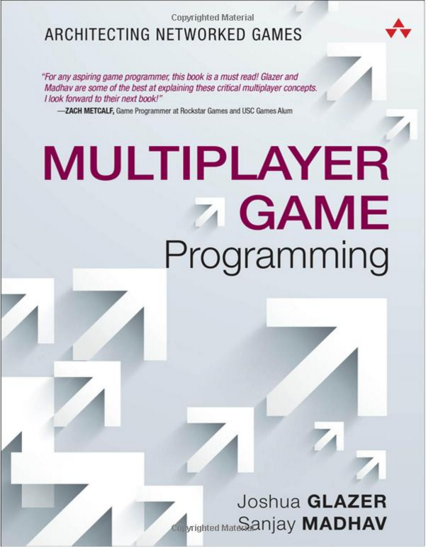
Reading
Separate from the lectures—you’re responsible for both!
Textbook reading assignments listed in syllabus, with a reminder on the entry tickets.
Notes:
[suggest new Network Programming textbook?]

Slide 19
Attendance
Life happens.
Missing a class is okay.
Talk to me about make-up work.
Missing a class without talking to me about it is not.
Excused absences carry no penalty (within reason).
Every unexcused absence past the second is -10%.

Slide 20
What is
Network
Programming
Programming

Slide 21
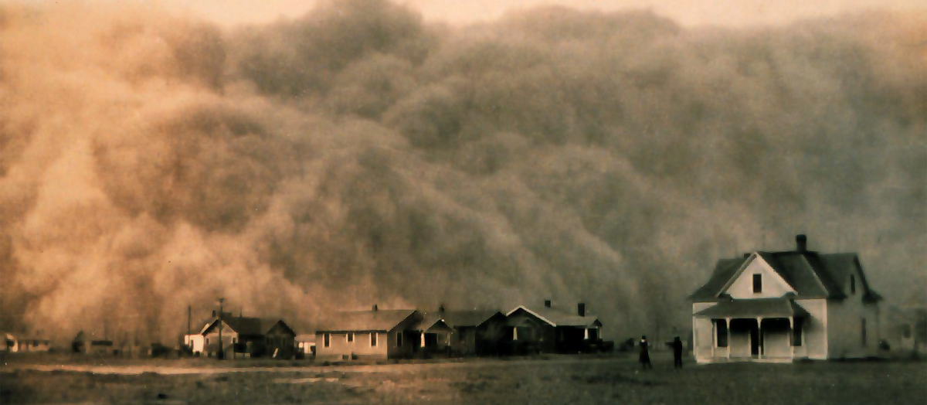
DUST: Danger, Uncertainty, Scale and Time

Slide 22

DANGER
If a system changes its behavior in response to external input, it can be hacked.
Notes:
Hack car computer via the radio from the tire pressure gauges [http://arstechnica.com/security/2010/08/cars-hacked-through-wireless-tyre-sensors/]
Hack pacemakers through their diagnostic ports [http://www.forbes.com/sites/singularity/2012/12/06/yes-you-can-hack-a-pacemaker-and-other-medical-devices-too/]
Hack traffic lights [http://arstechnica.com/security/2014/08/researchers-find-its-terrifyingly-easy-to-hack-traffic-lights/]
Many hacks require physical access, in which case not so big a problem. As a network programmer, however, you are introducing greater attack surface. It is your responsibility to keep the system safe.

Slide 23

UNCERTAINTY
You know nothing.
Notes:
- You don’t know what’s on the other end of the connection
⁃ You don’t know what they received from you
⁃ You don’t know what they’ve sent to you
⁃ You don’t know who else saw the data along the way
⁃ You don’t know who else injected data along the way
⁃ You don’t even know whether they’re still there
Makes it hard to develop, makes it doubly hard to debug.
HETEROGENEITY
PARTIAL FAILURE
Asynchronous networks are allowed to Duplicate Delay Drop Reorder Drops and delays are indistinguishable Byzantine networks are allowed to mess with messages arbitrarily Including rewriting their content They mostly don't happen in real networks Mostly

Slide 24
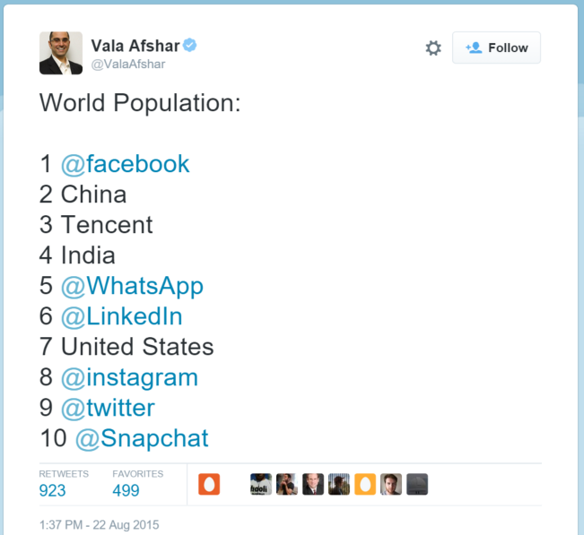
SCALE
A million users isn't cool.
A billion users is cool.
Notes:
Typical gaming machine can handle four, eight, sixteen, maybe 32 protagonists
⁃ Handling a million protagonists (WoW, LoL) is harder
⁃ It’s easy to handle a few hundred user accounts. Facebook has 1.3 billion.
Dealing with scale seems like it takes profoundly different techniques, but it’s actually just a case of choosing different tools to perform the same jobs you did at small scale. We’ll go into details on this later this year.

Slide 25
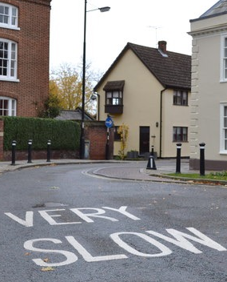
Time
300,000 km/sec:
It’s not just a good idea, IT’S THE LAW.
Notes:
[show a nanosecond]
Singapore is 42 milliseconds away (and that’s by undersea cable). By satellite it’s 280ms.
A computer can do math in half a nanosecond that takes us a second. So let’s scale computer speeds up by 2 billion to make them comprehensible to us. That means it takes:
⁃ One second to access L1 cache
⁃ 14 seconds to access L2 cache
⁃ 3 minutes to access main memory
⁃ So basically all of these are normal scale—if you’re in a real hurry (deadline!) you care, if you’re just doing your homework you don’t
⁃ 5 hours to send 1K bytes within a datacenter—that’s like sending an email
⁃ 1 week round trip within the same datacenter—that’s like sending something in the mail
⁃ 8 months to open a disk file
⁃ 10 years round trip between consumer machines (3 years per 100ms)
The other aspect of time, the corollary to this, is that things will be happening at the same time in different parts of your system.
SYNCHRONIZATION
LATENCY

Slide 26
DUST: Danger, Uncertainty, Scale and Time

